Slide 1

DIVORCE PREDICTION
Group 14
Btech 5th Sem
Skill Lab
Computer Engineering
Silicon University
Student Names and SIC NO
1.Akankshya Pattnaik 22BCEF36
2.Manaswini Mohapatra 22BCEE69
3.Abismruta Kar 22BCEE46
4.Mohit Prasad Mohanty 22BECF64

Slide 2

Abstract
Divorce is a complex social phenomenon with significant personal and societal impacts. This project aims to develop and evaluate machine learning models to predict the likelihood of divorce in couples. Utilizing a dataset containing various demographic, socio-economic, and relationship-related factors, we employ a range of supervised learning algorithms, including
KNN classification,
Logistic Regression,
Support Vector Machines,
Naïve Bayes, and
Decision tree
Model evaluation is conducted using metrics such as
Accuracy,
Precision,
Recall,
F1-score,
Confusion matrix,
Classification report, and
ROC-AUC curve
to assess predictive performance and identify the most effective model. The results of this study can provide valuable insights into the factors contributing to divorce and potentially assist in developing early intervention strategies to support couples at risk.

Slide 3
Agenda
Dataset Description
Methods and Algorithms
Evaluation Techniques
Result and Findings
Conclusion

Slide 4
Dataset Description
Dataset Overview
The "Predicting Divorce" dataset contains psychological and relational features derived from survey responses to assess factors that contribute to divorce likelihood. Each row represents an individual or couple, and columns represent specific questions or metrics related to relationship quality, communication, and satisfaction. This dataset is ideal for binary classification tasks, where the target variable indicates whether a couple is likely to divorce.
Features and Attributes
Relational Attributes: Questions assessing trust, communication, and conflict resolution in relationships.
Psychological Indicators: Features reflecting emotional connection, satisfaction, and compatibility.
Target Variable: Binary indicator of divorce likelihood (e.g., 0 for stable marriage, 1 for divorce).
Dataset Sizing and Data Distribution
The "Predicting Divorce" dataset is containing approximately 170 rows and 54 columns, including relational and psychological attributes. Each row represents a couple's survey responses, with columns reflecting relationship dynamics and a target variable for divorce likelihood. Its compact size makes it ideal for quick exploratory analysis and lightweight machine learning models.

Slide 5
Methods
KNN
KNN is a non-parametric algorithm that classifies data points based on the majority class of their nearest neighbors, making it simple and effective for small datasets.
LOGISTIC REGRESSION
Logistic Regression is a statistical model used for binary classification, predicting the probability of an outcome using a sigmoid function.
SUPPORT VECTOR MACHINE
Support Vector Machine (SVM) is a supervised machine learning algorithm that finds the optimal hyperplane to separate data points into distinct classes for classification tasks or fits a regression line for regression tasks. It uses a kernel trick to handle non-linear data effectively.
NAÏVE BAYES
Naive Bayes is a probabilistic algorithm based on Bayes' Theorem, assuming independence among predictors, and is particularly effective for text classification.
DECISION TREE
Decision Tree is a tree-structured algorithm that splits data based on feature conditions, creating a flowchart-like structure for classification or regression tasks.

Slide 6
Evaluation Techniques
Accuracy The proportion of correctly classified instances out of the total instances.
ROC-AUC curve A metric indicating the ability of a model to distinguish between classes, based on the area under the ROC curve.
F1 score The harmonic mean of precision and recall, balancing the trade-off between the two.
Precision The proportion of true positives among all instances predicted as positive.
Recall The proportion of true positives among all actual positive instances.
Confusion Matrix A table summarizing the performance of a classification model by showing true positives, true negatives, false positives, and false negatives.
Classification Report A detailed summary of precision, recall, F1-score, and support for each class.
 | Predicted Positive | Predicted Negative
Actual Positive | True Positive | False Negative
Actual Negative | False Positive | True Negative

Slide 7
Result
MODEL | ACCURACY | PRECISION (class 0,1) | RECALL (class 0,1) | F1-SCORE (class 0,1) | CONFUSION MATRIX | ROC-AUC
KNN | 0.97 | 0.93, 1.00 | 1.00, 0.95 | 0.97, 0.97 | [[14,0], [1,19]] | 1.00
SVM | 1.00 | 1.00, 1.00 | 1.00, 1.00 | 1.00, 1.00 | [[14, 0], [0, 20]] | 1.00
NAÏVE BAYES | 0.9412 | 0.93, 0.95 | 0.93, 0.95 | 0.93, 0.95 | [[13, 1], [1, 19]] | 0.96
LOGISTIC REGRESSION | 1.00 | 1.00, 1.00 | 1.00, 1.00 | 1.00, 1.00 | [[14, 0], [0, 20]] | 1.00
DECISION TREE | 0.9412 | 0.93, 0.95 | 0.93, 0.95 | 0.93, 0.95 | [[13, 1], [1, 19]] | 0.94

Slide 8
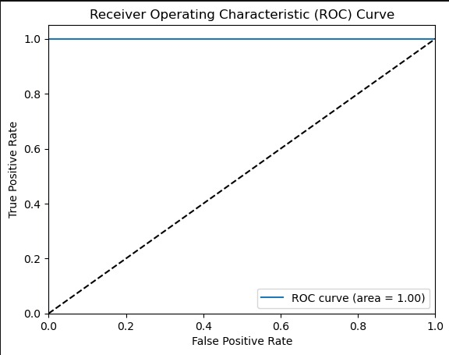
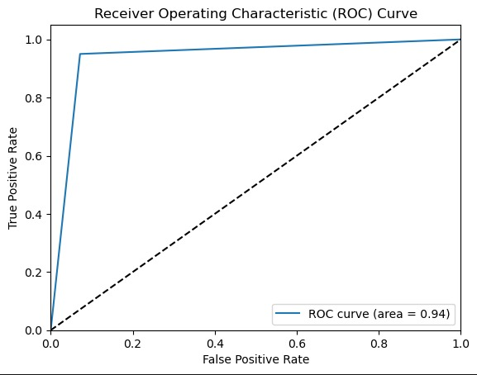
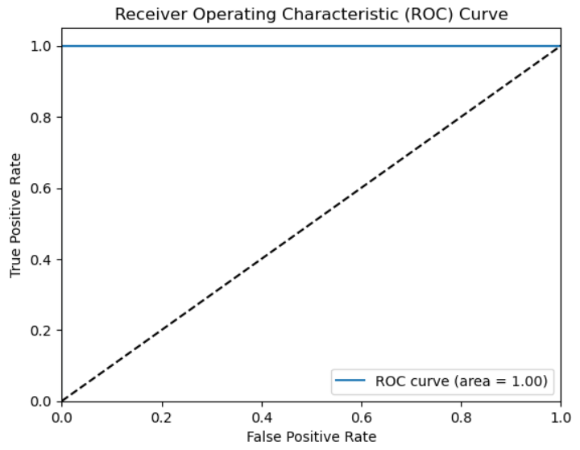
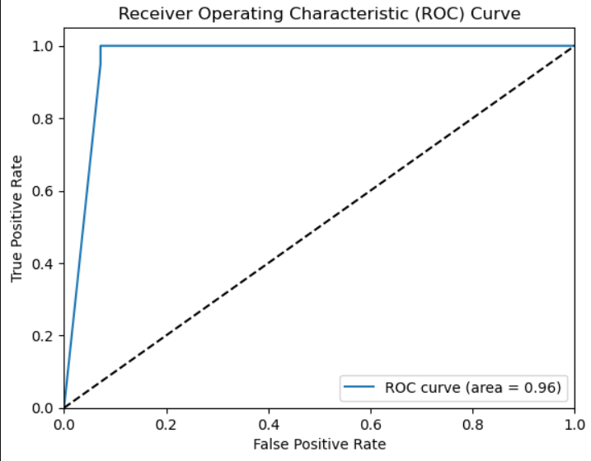
ROC-AUC
KNN
DECISION TREE
LOGISTIC REGRESSION
NAÏVE BAYES
SVM

Slide 9
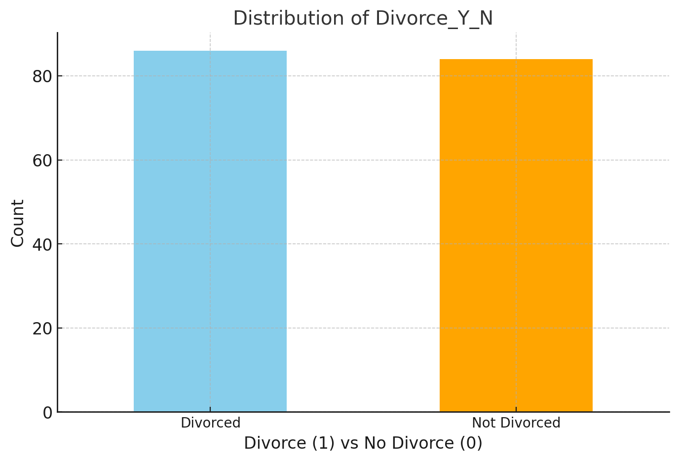
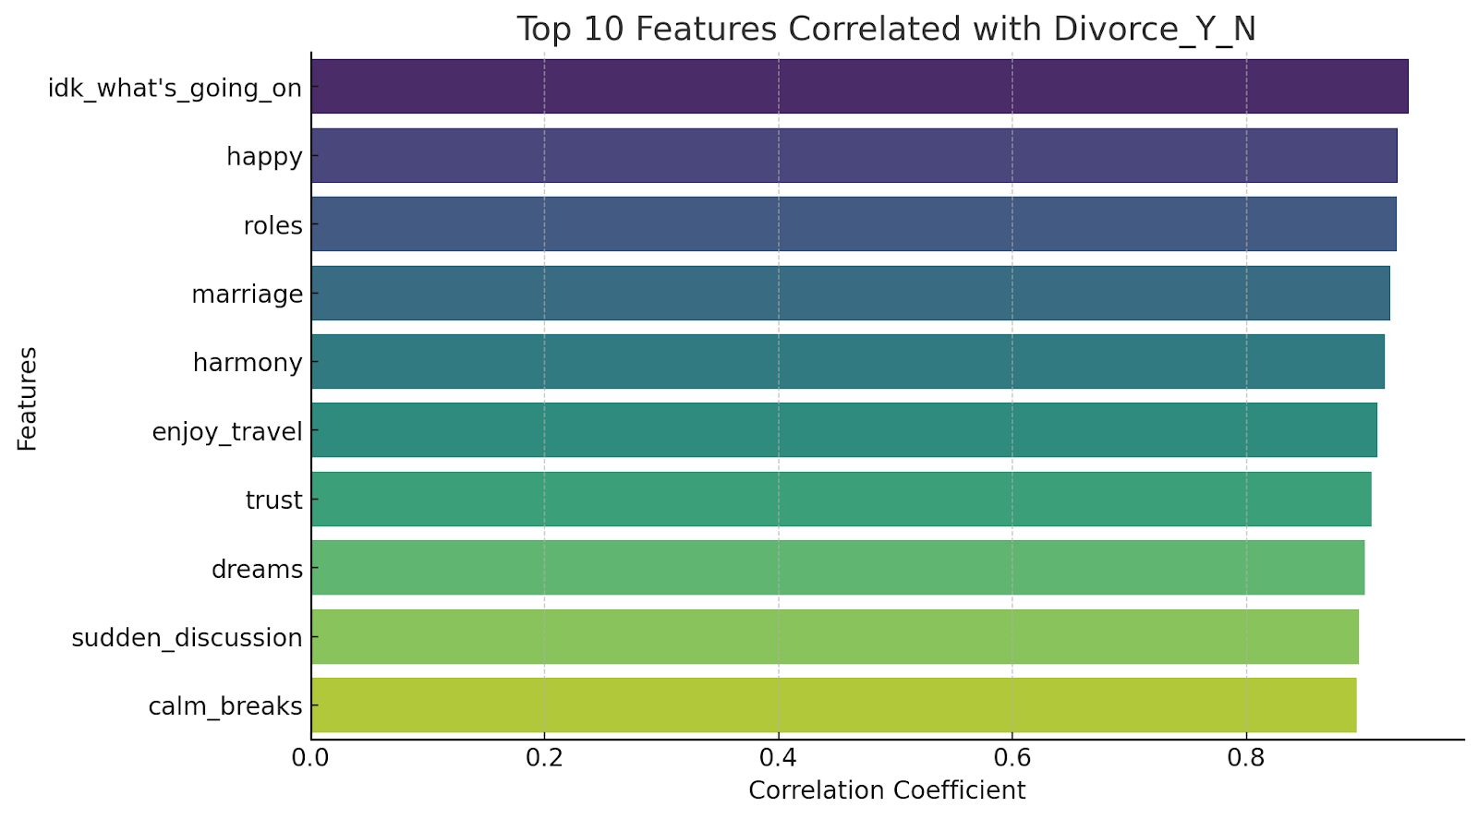
RESULTING GRAPHS

Slide 10
Conclusion
This project effectively used SVM and Logistic Regression to predict divorce, achieving an impressive 100% accuracy. SVM excelled at identifying complex patterns, while Logistic Regression offered simplicity and highlighted key factors like communication and trust. Both models proved reliable and insightful, demonstrating the potential of machine learning in analyzing relationships. Future enhancements, such as adding more data and exploring additional features, could further improve prediction accuracy and provide deeper insights into marital dynamics.

Slide 11
Reference
DATASET SOURCED FROM
https://www.kaggle.com/datasets/csafrit2/predicting-divorce

Slide 12
Thank you

